Slide 1
Zomato Food Delivery & Recommendation

Slide 2
TEAM Members
Saket Suhane
Achal Singh
Pranav Pramod
Venkatesh Nayak

Slide 3
Project Journey
Phase 1
Phase 2
Phase 3
Phase 4
Deployment of Model with help of HTML
Scrapped the data with the help of Beautiful Soup and Selenium
Understanding the problem statement and started working on web scrapping
Cleaned the Raw data and started working on model prediction

Slide 4
Problem Statement
Scrape data from food delivery platform Zomato using python library and collect information.
After that, build a recommendation model for someone who wants to open a restaurant in Bangalore.
ZOMATO

Slide 5
Challenges
Learning the different tools for data scraping
Data cleaning, analyzing and generating insights with the help of the dashboard
Dynamic Page scrolling was another issue faced
Finding the Xpath and reading the HTML file

Slide 6
Approach
Web Scrapping
Model Building
Data Cleaning
Model Deployment
Worked on different models and Random Forest was the best suitable
Scrapped the data using Beautiful soup and Selenium for scrolling
Cleaning the Raw data using Numpy and Panadas
Deployed the model on HTML webpage

Slide 7
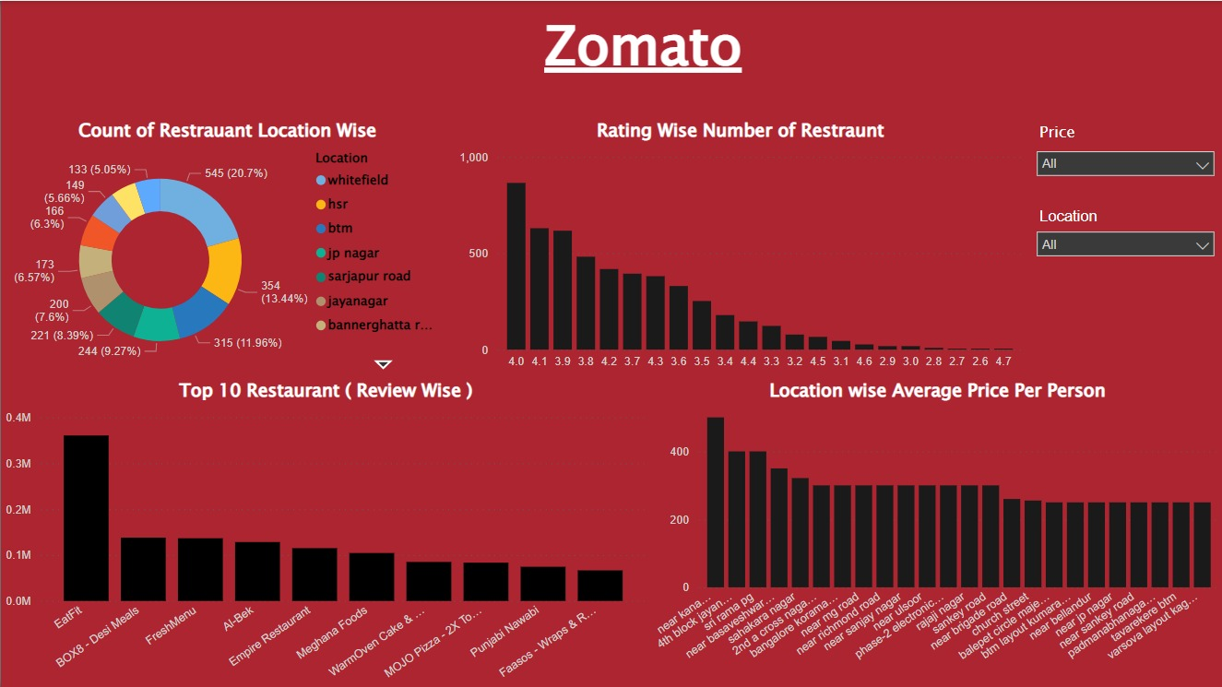
Dashboard Insights

Slide 8
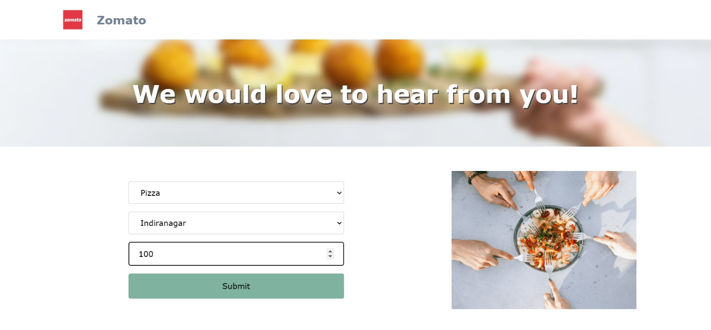
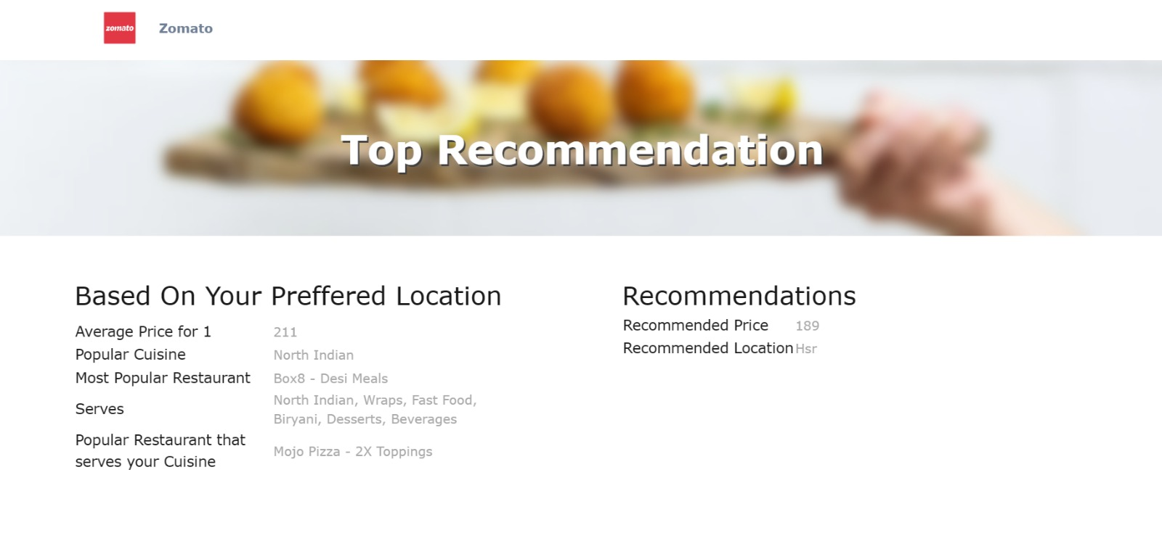
Input
Output
We need to provide Cuisine, Price and preferred location to get the recommendation
Here we can get famous restaurant, Average price and also the recommended Price and Location

Slide 9
Zomato Web page

Slide 10
Recommendations
For Price and Location

Slide 11
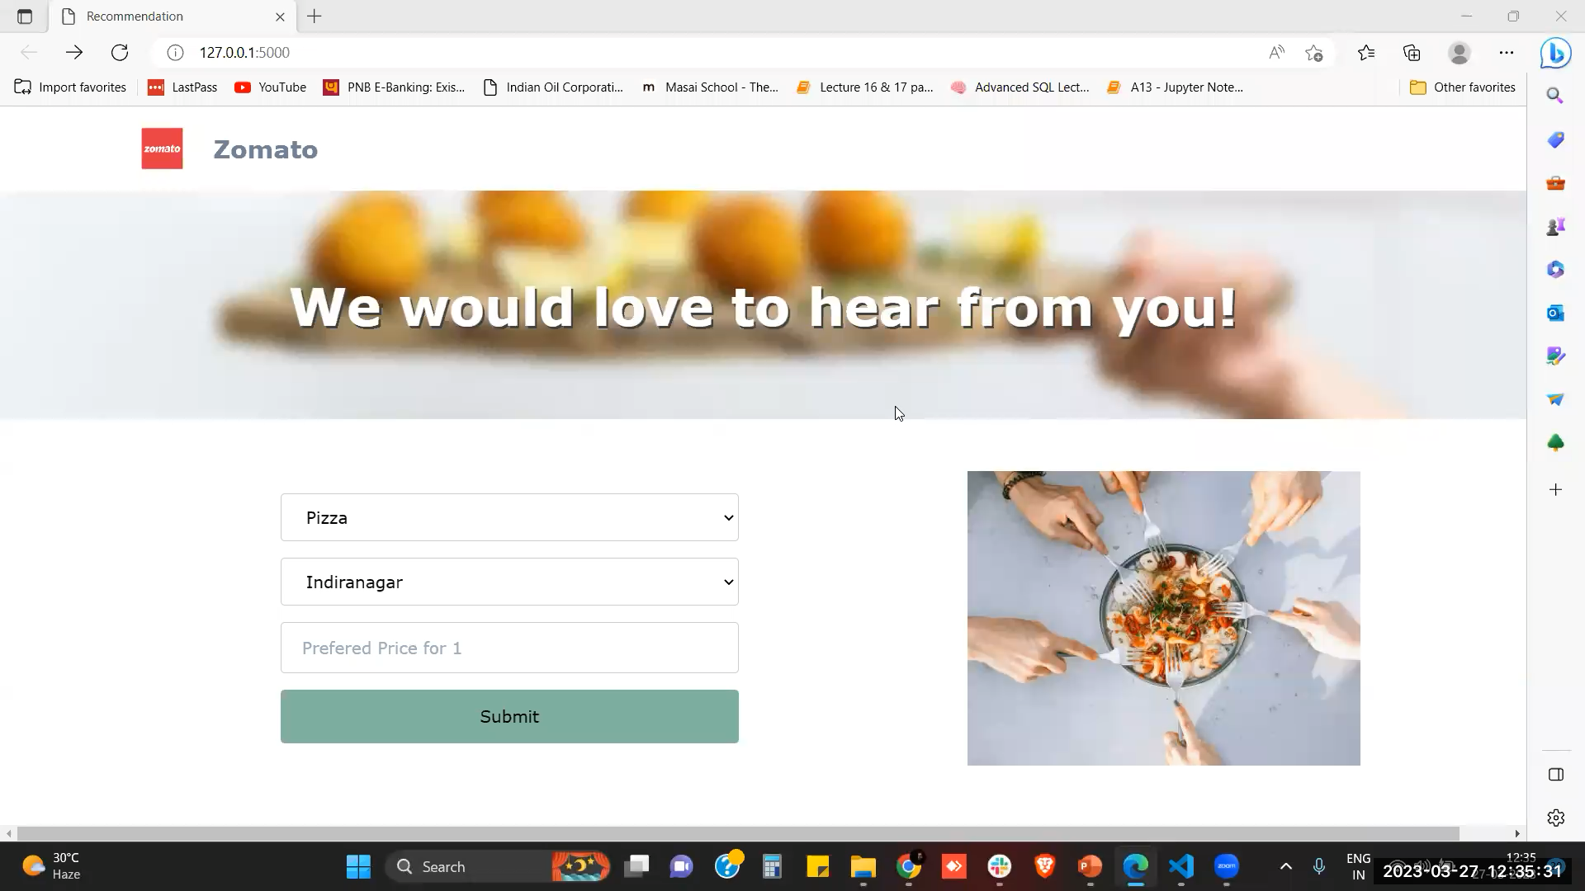
Product Demo
Insert your preferred Cuisine, price and location

Slide 12
Conclusion
We were able scrape the Zomato website successful and were able to extract around 3000 records.
The dataset which was recovered after web scraping were very less correlated to the target label. There was a lot of noise in the data as well.
Due to less features and lower correlation between the features and the label, the model was having very low accuracy.
If there were more number of features and higher co-linearity between the features and the target label, the model would may had higher accuracy.

Slide 13
Future Scope
The future scope of this project would deal with the successful recommendation of restaurants or any other activity for that matter. Taking the input of customers and based on said input, provide insights as to where their ideal place would be and what exactly is the price, etc.

Slide 14
Thank You
Do you have any questions?

